Slide 1
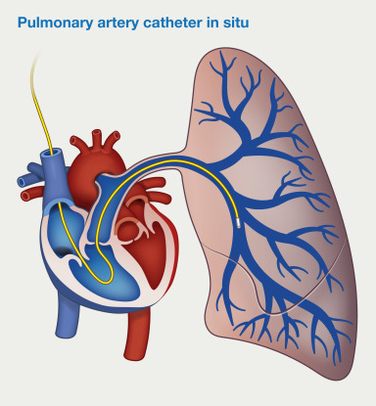
Continue unit - 2
Pulmonary arterial pressure monitoring
By
Hussain Bux Soomro
LECTURER CON (F) SHIKARPUR

Slide 2
Pulmonary Arterial Pressure Monitoring
Pulmonary Arterial Pressure (PAP) Monitoring is a critical procedure used to assess right heart function and pulmonary circulation. It is commonly done using a pulmonary artery catheter (PAC), also called a Swan-Ganz catheter.
The Swan-Ganz catheter is synonymous with a pulmonary artery catheterization. It was named in honor of its inventors who were Jeremy Swan and William Ganz from Cedars-Sinai Medical Center in 1970.
The catheters size range from 60 to 110 cm in length and 4F to 8F in caliber
Inserted percutaneously into a major vein (jugular, subclavian, femoral) via an introducer sheath.
Passage is easier when the patient is placed flat or slightly upright.

Slide 3
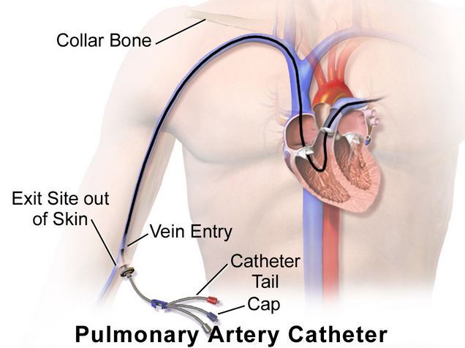
Indications
Diagnosis and management of pulmonary hypertension
Assessing heart failure severity
Monitoring patients with shock (cardiogenic, septic, etc.)
Guiding fluid and vasopressor therapy in critically ill patients
Evaluating right ventricular function
Hemodynamic instability after cardiac surgery

Slide 4
CONTRAINDICATIONS
Tricuspid or pulmonary valve mechanical prosthesis
Right heart mass (thrombus and/or tumor)
Tricuspid or pulmonary valve endocarditis

Slide 5
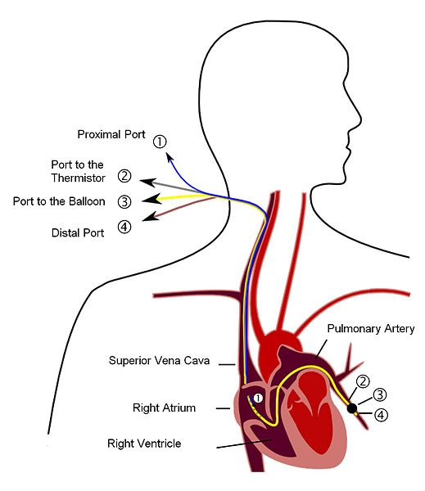
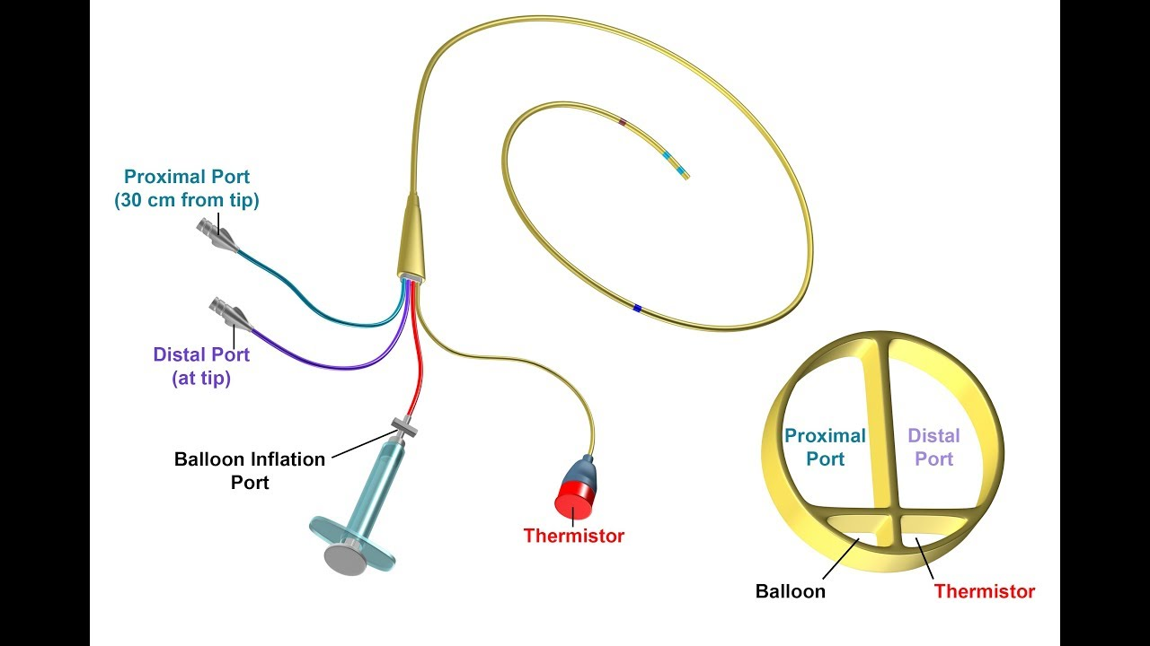
Pulmonary artery catheter (swan ganz catheter)

Slide 6
Pulmonary artery catheter (swan ganz catheter)
Lumen (Port) | Color | Location | Function
Proximal Lumen | Blue | Right Atrium | - Measures Central Venous Pressure (CVP) - Used for fluid/medication administration - Injects cold saline for cardiac output measurement
Distal Lumen | Yellow | Pulmonary Artery | - Measures Pulmonary Artery Pressure (PAP) - Used for Mixed Venous Oxygen Saturation (SvO₂) monitoring
Balloon Lumen | Red | Pulmonary Artery (Balloon Tip) | - Inflates balloon for Pulmonary Artery Wedge Pressure (PAWP) measurement - Helps in catheter advancement
Thermistor Lumen | - | Near Distal Lumen | - Measures blood temperature - Used for cardiac output measurement via thermodilution

Slide 7
Transducers Setup for Pressure Monitoring
Pressure Transducer: The ports (proximal, distal, and balloon) are connected to pressure transducers, which convert pressure into electrical signals.
Cardiac Output: The thermistor lumen is connected to a monitoring system that calculates cardiac output based on the temperature change from the thermodilution method.
Display on Monitor: These measurements (CVP, PAP, PAWP, CO) are displayed on the monitor, and the readings are continuously updated, allowing clinicians to adjust treatment as needed.

Slide 8
Normal ranges of parameters
Measurement | Normal Range | Purpose
CVP (Central Venous Pressure) | 2-8 mmHg | Assesses fluid status, diagnoses heart failure
PAP (Pulmonary Artery Pressure) | Systolic 15-30 mmHg, Diastolic 8-15 mmHg | Monitors lung pressure, detects pulmonary hypertension
PAWP (Pulmonary Artery Wedge Pressure) OR Pulmonary Capillary Wedge Pressure (PCWP) | 6-12 mmHg | Assesses left atrial pressure (LAP) because we cannot measure the LAP directly , detects pulmonary edema
Cardiac Output (CO) | 4-8 L/min | Evaluates heart function and pumping capacity
SVR (Systemic Vascular Resistance) | 900-1400 dynes/sec/cm⁵ | Determines blood vessel constriction
SvO₂ (Mixed Venous Oxygen Saturation) | 60-80% | Measures tissue oxygen delivery

Slide 9
Cardiac output monitoring

Slide 10
Nursing considerations
Confirm catheter placement using a chest X-ray (to check for complications like pneumothorax).
Follow strict aseptic technique during care and dressing changes
Interpret waveforms to assess fluid status, heart function, and response to treatment.
Air Embolism: Ensure all connections are secure and no air enters the system.
Thrombus Formation: Flush the catheter with heparinized saline as per protocol.
Arrhythmias: Monitor ECG for any dysrhythmias caused by catheter movement
Have the patient hold their breath during removal of catheter to prevent air embolism.

Slide 11
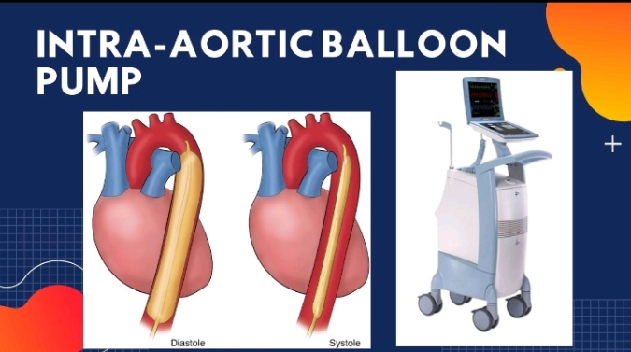

Slide 12
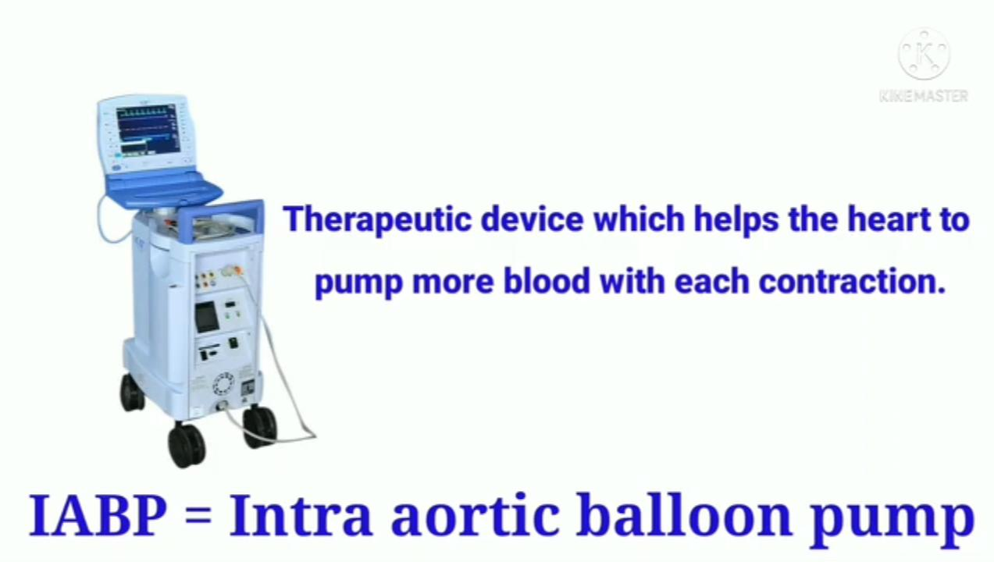

Slide 13
IABP (INTRA-AORTIC BALLOON PUMP)
An intra-aortic balloon pump(IABP) is a type of therapeutic device.
It helps your heart pump more blood. You may need it, if your heart is unable to pump enough blood for your body.
IABP gives temporary support for the left ventricle by mechanically displacing blood within the aorta.
it is consist of two parts : a balloon inserted into the aorta, one of the large arteries though which blood passes from the heart to the rest of the body , and a machine/ console outside the body

Slide 14
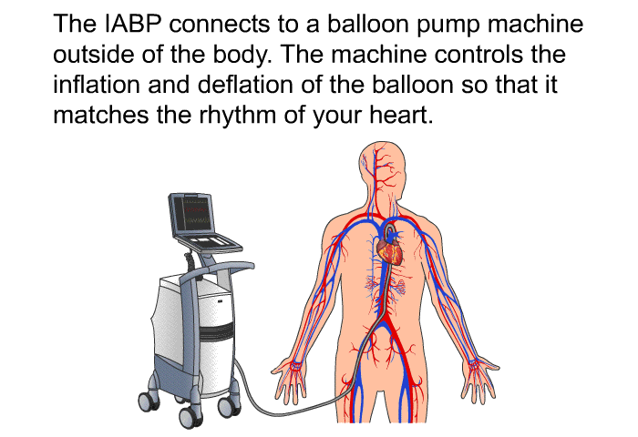

Slide 15


Slide 16


Slide 17
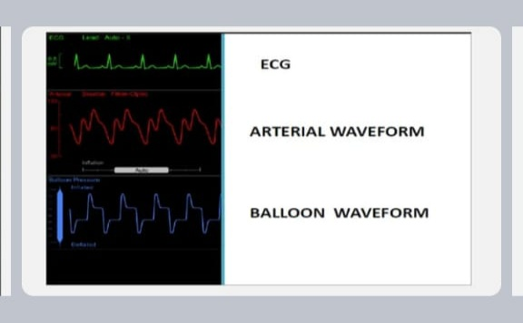
Hemodynamic monitor

Slide 18
IABP Purposes
To increase myocardial oxygen supply.
To decrease myocardial oxygen demand.
To improve cardiac out put.
Indication
Severe Angina
Cardiogenic shock after MI
Left ventricular failure after cardiac surgery
Angioplasty /bypass failure

Slide 19
Contraindications
Aortic valve insufficiency
Severe peripheral vascular occlusive disease
Any previous aortofemoral or aortoilliac bypass graft
Aortic dissection
Complications
Limb ischemia..
Heparin induced Platelet destruction.
Aortic dissection or perforation.
Malposition.

Slide 20
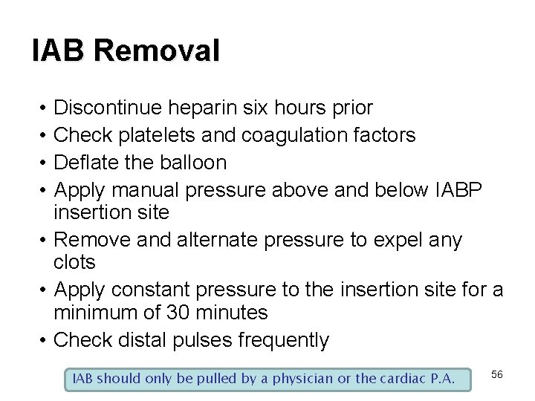

Slide 21
Nursing care
nursing care involves the hemodynamic assessment, fluid balance, positioning and pressure area care, observation of the balloon catheter and line, asses the limb perfusion, neurological status.
Check distal\limb pulses color, temperature, and capillary refill.
Daily platelets monitoring.
Observe insertion site.
Assess cardiac output.
Observe complications.

Slide 22
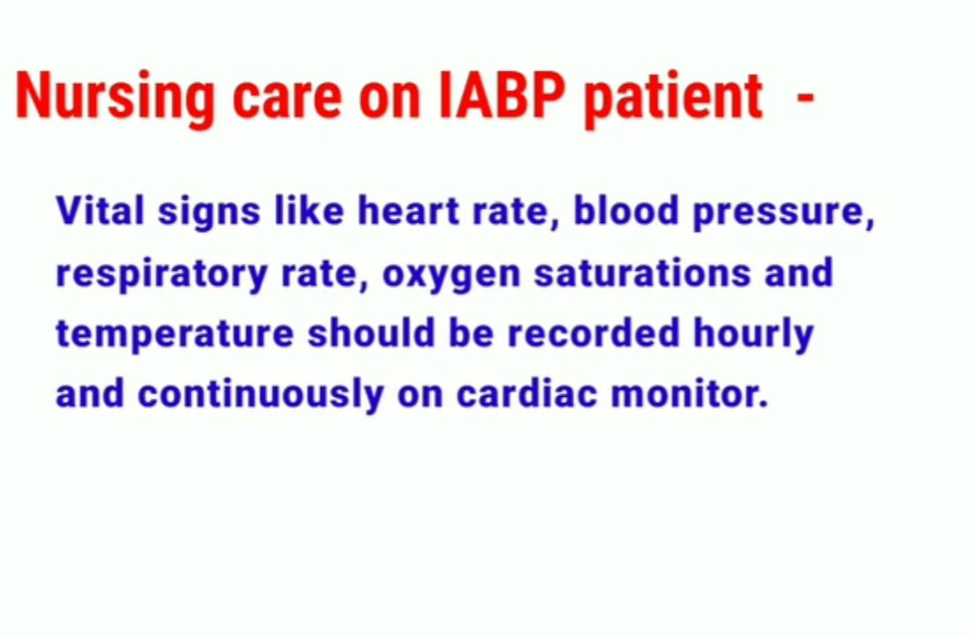

Slide 23
References:
A prospective randomized study comparing surgical and Percutaneous removal of Intraaortic Balloon pumps Michael, j. Rohrer et al
Cardiopulmonary bypass principle and techniques –Amman Jordan

Slide 24


